Slide 1
POS tAGGING

Slide 2
What is Part-of-Speech (POS)
Generally speaking, Word Classes (=POS) :
Verb, Noun, Adjective, Adverb, Article, …
We can also include inflection:
Verbs: Tense, number, …
Nouns: Number, proper/common, …
Adjectives: comparative, superlative, …
…

Slide 3
Parts of Speech
8 (ish) traditional parts of speech
Noun, verb, adjective, preposition, adverb, article, interjection, pronoun, conjunction, etc
Called: parts-of-speech, lexical categories, word classes, morphological classes, lexical tags...

Slide 4
7 Traditional POS Categories
N noun chair, bandwidth, pacing
V verb study, debate, munch
ADJ adj purple, tall, ridiculous
ADV adverb unfortunately, slowly,
P preposition of, by, to
PRO pronoun I, me, mine
DET determiner the, a, that, those

Slide 5
POS Tagging
The process of assigning a part-of-speech or lexical class marker to each word in a collection.
WORD tag
the DET
koala N
put V
the DET
keys N
on P
the DET
table N

Slide 6
Penn TreeBank POS Tag Set
Penn Treebank: hand-annotated corpus of Wall Street Journal, 1M words
45 tags

Slide 7
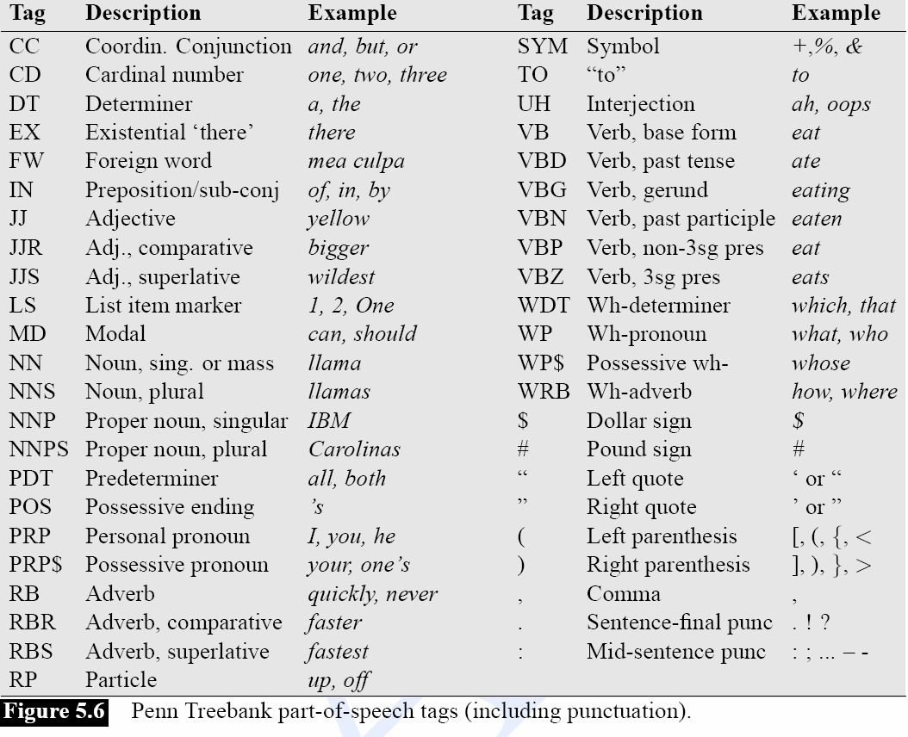
Penn Treebank Tagset

Slide 8
POS Tagging Choosing a Tagset
There are so many parts of speech, potential distinctions we can draw
To do POS tagging, we need to choose a standard set of tags to work with
Could pick very coarse tagsets
N, V, Adj, Adv.
More commonly used set is finer grained, the “Penn TreeBank tagset”, 45 tags

Slide 9
Using the Penn Tagset
The/DT grand/JJ jury/NN commmented/VBD on/IN a/DT number/NN of/IN other/JJ topics/NNS ./.
Prepositions and subordinating conjunctions marked IN (“although/IN I/PRP..”)
Except the preposition/complementizer “to” is just marked “TO”.

Slide 10
POS Tagging
Words often have more than one POS: back
The back door = JJ
On my back = NN
Win the voters back = RB
Promised to back the bill = VB
The POS tagging problem is to determine the POS tag for a particular instance of a word.
These examples from Dekang Lin

Slide 11
Quick Test: Agreement?
the students went to class
plays well with others
fruit flies like a banana
DT: the, this, that
NN: noun
VB: verb
P: prepostion
ADV: adverb

Slide 12
Quick Test
the students went to class
DT NN VB P NN
plays well with others
VB ADV P NN
NN NN P DT
fruit flies like a banana
NN NN VB DT NN
NN VB P DT NN
NN NN P DT NN
NN VB VB DT NN

Slide 13
Two Methods for POS Tagging
Rule-based tagging
(ENGTWOL)
Stochastic
Probabilistic sequence models
HMM (Hidden Markov Model) tagging
MEMMs (Maximum Entropy Markov Models)

Slide 14
Rule-Based Tagging
Start with a dictionary
Assign all possible tags to words from the dictionary
Write rules by hand to selectively remove tags
Leaving the correct tag for each word.

Slide 15
Rule-based taggers
Early POS taggers all hand-coded
Most of these (Harris, 1962; Greene and Rubin, 1971) and the best of the recent ones, ENGTWOL (Voutilainen, 1995) based on a two-stage architecture
Stage 1: look up word in lexicon to give list of potential POSs
Stage 2: Apply rules which certify or disallow tag sequences
Rules originally handwritten; more recently Machine Learning methods can be used

Slide 16
Start With a Dictionary
she: PRP
promised: VBN,VBD
to TO
back: VB, JJ, RB, NN
the: DT
bill: NN, VB
Etc… for the ~100,000 words of English with more than 1 tag

Slide 17
Assign Every Possible Tag
NN
RB
VBN JJ VB
PRP VBD TO VB DT NN
She promised to back the bill

Slide 18
Write Rules to Eliminate Tags
Eliminate VBN if VBD is an option when VBN|VBD follows “<start> PRP”
NN
RB
JJ VB
PRP VBD TO VB DT NN
She promised to back the bill
VBN

Slide 19
POS tagging
The involvement of ion channels in B and T lymphocyte activation is
DT NN IN NN NNS IN NN CC NN NN NN VBZ
supported by many reports of changes in ion fluxes and membrane
VBN IN JJ NNS IN NNS IN NN NNS CC NN
…………………………………………………………………………………….
…………………………………………………………………………………….
training
Unseen text
Machine Learning
Algorithm
We demonstrate
PRP VBP
that …
IN
We demonstrate
that …

Slide 20
Goal of POS Tagging
We want the best set of tags for a sequence of words (a sentence)
W — a sequence of words
T — a sequence of tags
Our
Goal
Example:
P((NN NN P DET ADJ NN) | (heat oil in a large pot))

Slide 21
But, the Sparse Data Problem …
Rich Models often require vast amounts of data
Count up instances of the string "heat oil in a large pot" in the training corpus, and pick the most common tag assignment to the string..
Too many possible combinations

Slide 22
POS Tagging as Sequence Classification
We are given a sentence (an “observation” or “sequence of observations”)
Secretariat is expected to race tomorrow
What is the best sequence of tags that corresponds to this sequence of observations?
Probabilistic view:
Consider all possible sequences of tags
Out of this universe of sequences, choose the tag sequence which is most probable given the observation sequence of n words w₁…w_{n}.

Slide 23
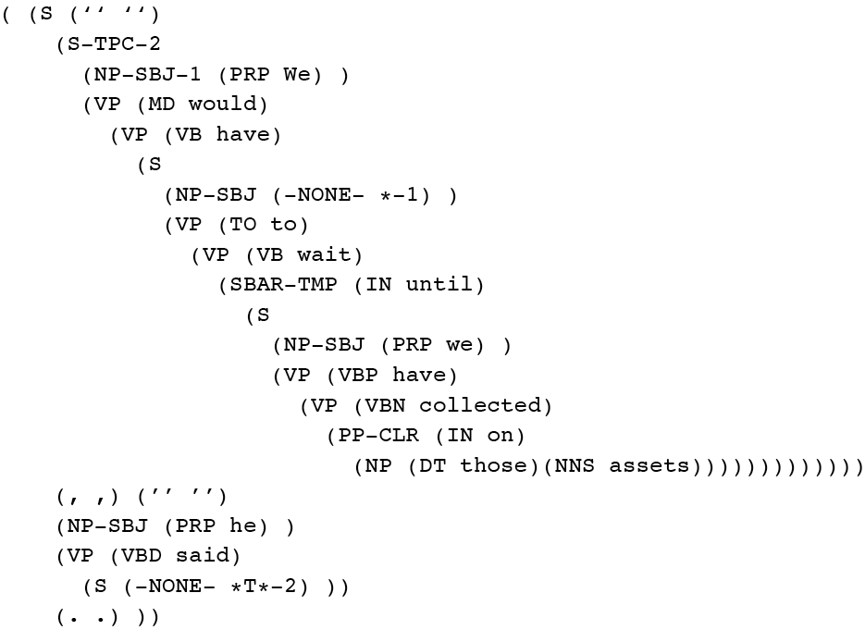
Penn Treebank
Penn TreeBank is a widely used treebank.
Most well known is the Wall Street Journal section of the Penn TreeBank.
1 M words from the 1987-1989 Wall Street Journal.

Slide 24
Treebank Grammars
Treebanks implicitly define a grammar for the language covered in the treebank.
Simply take the local rules that make up the sub-trees in all the trees in the collection and you have a grammar.
Not complete, but if you have decent size corpus, you’ll have a grammar with decent coverage.

